Slide 1
PA 604
Qualitative Data Analysis
PROFESSOR BURREL VANN JR

Slide 2
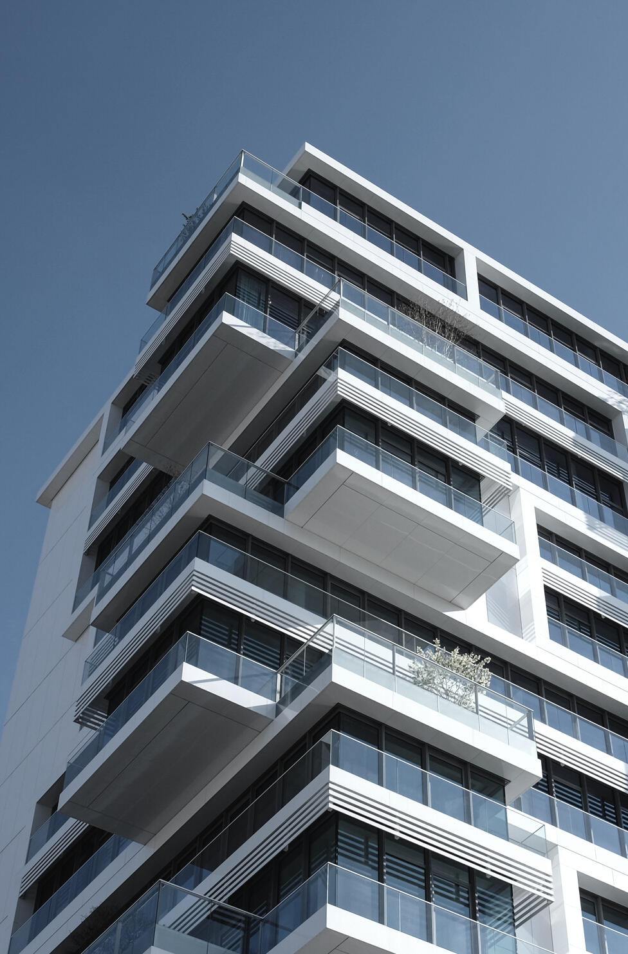
Qualitative Analysis
The examination and interpretation of non-numerical observations
Discover underlying meanings and patterns
Notes:
Qualitative analysis involves an interplay between data collection, analysis, and theory. All intertwine.
While some qualitative work is descriptive, qualitative analysis aims to explain patterns.

Slide 3
Data Analysis
Unobtrusive
DATA CONVERTED TO TEXT
field notes, recorded interviews, pictures, responses, etc transcribed into written format
researcher examines text for patterns, themes, experiences, meanings
Notes:
Frequencies/Magnitudes
Structures
Processes
Causes
Consequences
1: how often does child abuse occur in families in neighborhood under study?
2: what are levels/brutality of abuse?
3: what are the different types/categories (mental, physical, sexual)?
4: what is the process by which abuse occurs? Doe abusers begin with mental then move on to other types?
5: is abuse more common amongst certain groups (SES? Racial groups? Religious groups?)?
6: how does abuse affect victims?

Slide 4


Data Analysis
INTERVIEWS
Transcripts, notes from interviewing people
ETHNOGRAPHY
Notes about your interactions with people, feelings, interactions with space, people’s interpretation of their lived experience
Looks at "the stuff" of life in a social context

Slide 5
Data Analysis
PARTICIPANT-OBSERVATION
Notes about interactions w/ people, notes about research feelings, interpretations

Slide 6
Data Analysis
CONTENT ANALYSIS
Text used as measure of relationships, meaning,
Newspapers, Journals, Blogs, Tweets

Slide 7
observations compared with one another and with the evolving inductive grounded theory
CONSTANT COMPARISON FOR THEORY-BUILDING
Notes:
Looking for evidence of similar incidents across cases
Notes relationships between concepts/phenomena, integrates details about cases and their properties
Delimiting/Writing the theory

Slide 8
Codes and Coding
CODING
Classifying or categorizing individual pieces of data, coupled with some kind of retrieval system.
CODING UNITS
Interview (notes, memos)
Book, paragraph, sentence?
OPEN CODING
the initial classification and labeling of concepts in qualitative data analysis.
a reanalysis of the results, aimed at identifying the important, general concepts.
Identify the central concept that organizes the other concepts.
Notes:
Usually, these will be large amounts of text notes that you’ve taken and maybe put into electronic format. Makes it easier to retrieve your data.
Coding units vary in size within units of analysis (from concept to concept) and between units of analysis (from cases to case if not just studying one unit)… if you’re studying political organizations: variables for mission will vary in size per organization, size of membership could be just a few words/numbers, ideology could all be about two lines.
You want to create codes in such a way that you can “try to” test hypotheses from previous work.
You begin by reading a body of text (part of interview or whole), and reread it, and try to identify concepts contained within it… might be a good time for a concept map
“ I though the professor should have given me at least partial credit for the homework I turned in” contains: professor, homework, grading, student-faculty relations…
Read pages 424-426 for a good example of HOW coding goes on (under the term selective coding).

Slide 9
Codes and Coding
PRACTICE THEMES
"… and I thought the professor should have given me at least partial credit for the homework I turned in...”
Notes:
Professor, Student, Homework, Grades, Tardiness, Perceptions of Fairness, Entitlement,

Slide 10
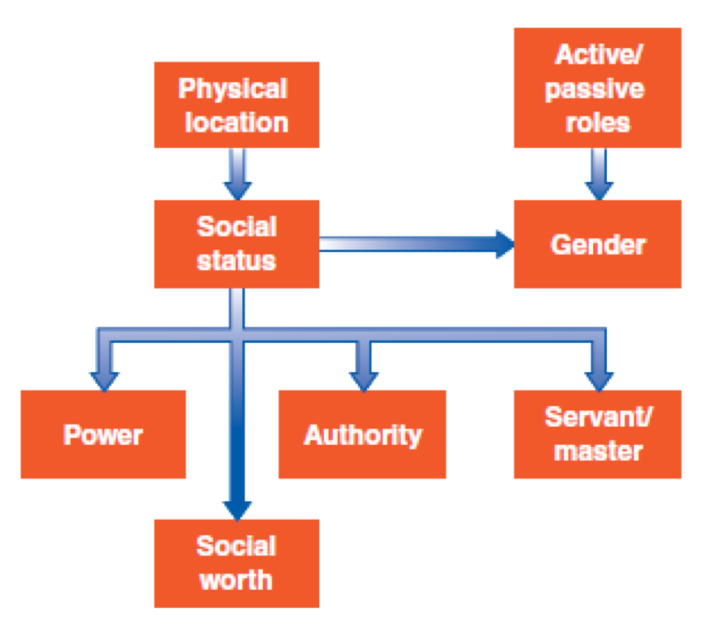
CONCEPT-MAPPING
The graphic display of concepts and their interrelations, useful in the formulation of theory.

Slide 11
Qualitative Data Analysis Programs
Atlas.ti
Dedoose
MAXQDA
Google Forms
Notes:
Just programs to help you organize and analyze your data. You can use something as simple as a spreadsheet or something more.
https://atlasti.com/
https://www.dedoose.com/
http://www.maxqda.com/

Slide 12
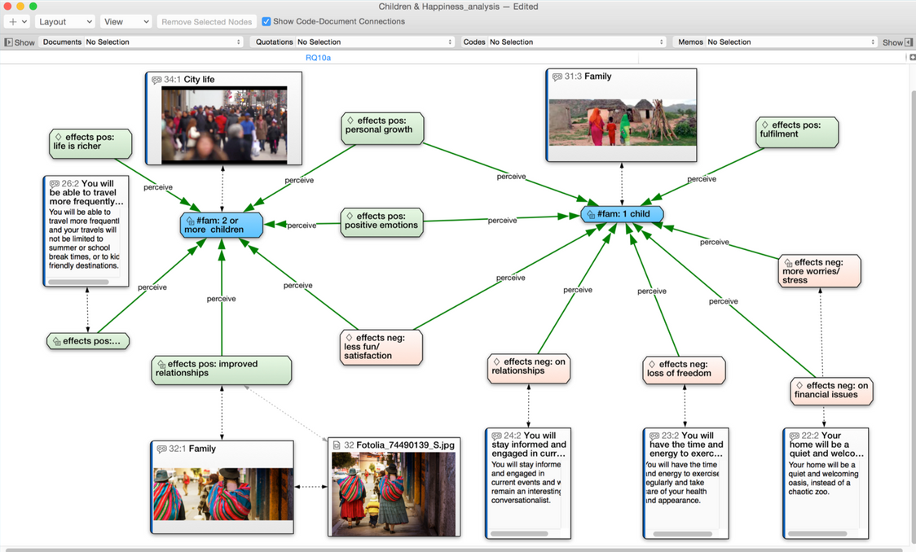
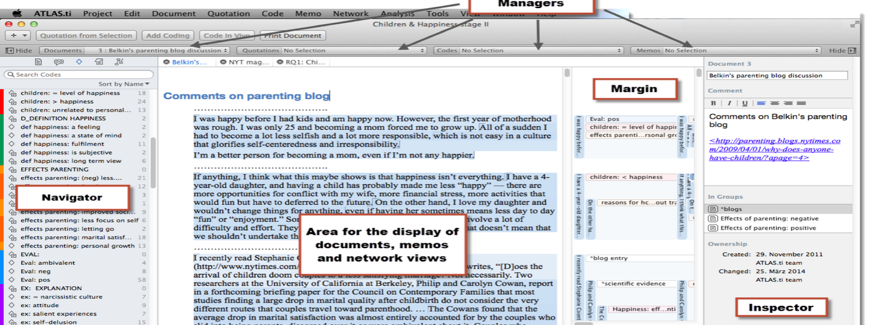
Atlas.ti

Slide 13
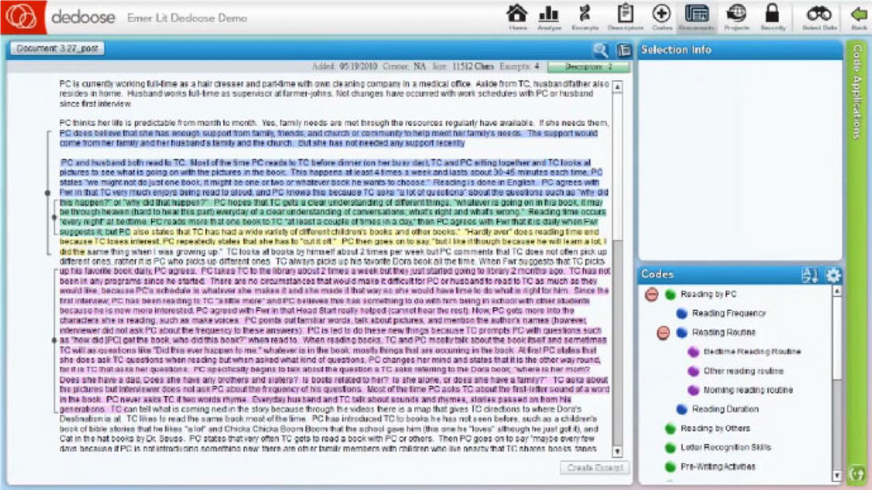
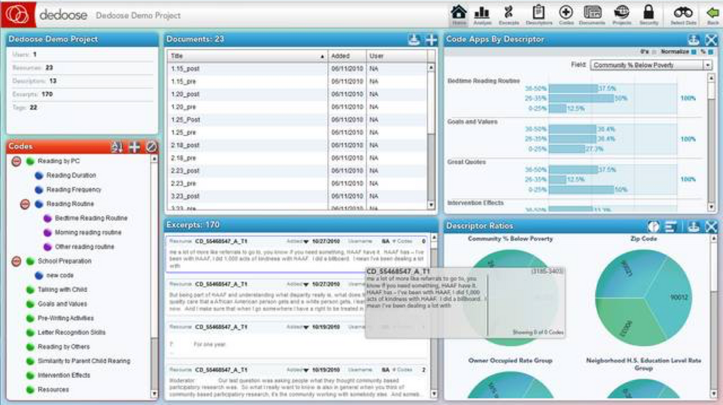
Dedoose

